Slide 1


Figures? Words?
Translation from image to words
A image is a set of scenes and semantic meanings
Did Google Brain watch this movie before their research?(Lol)

Slide 2
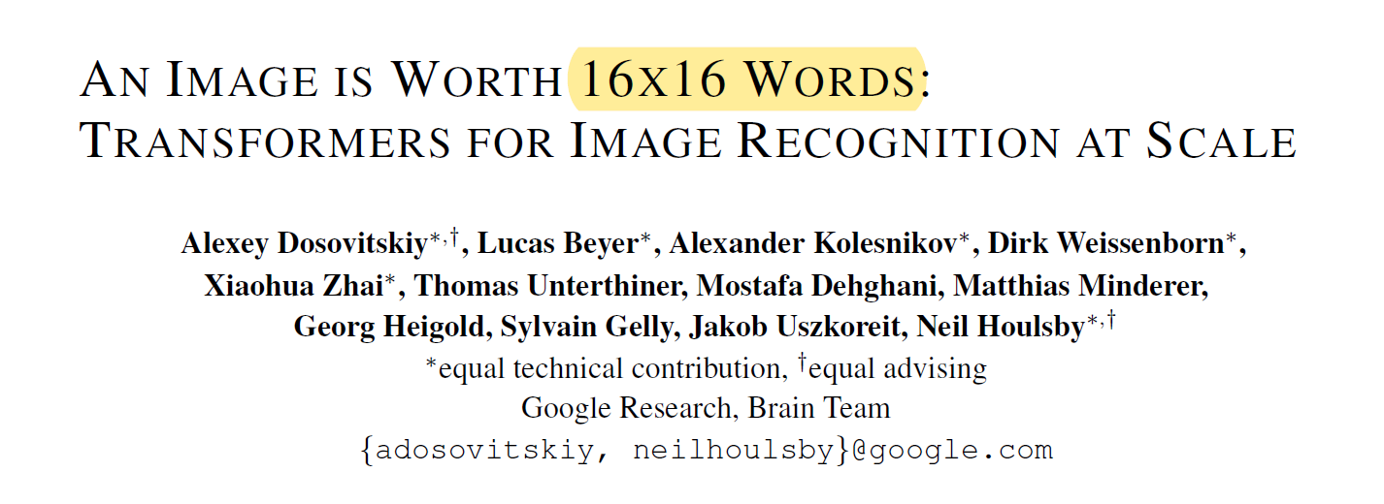

Slide 3
Achivements

Slide 4
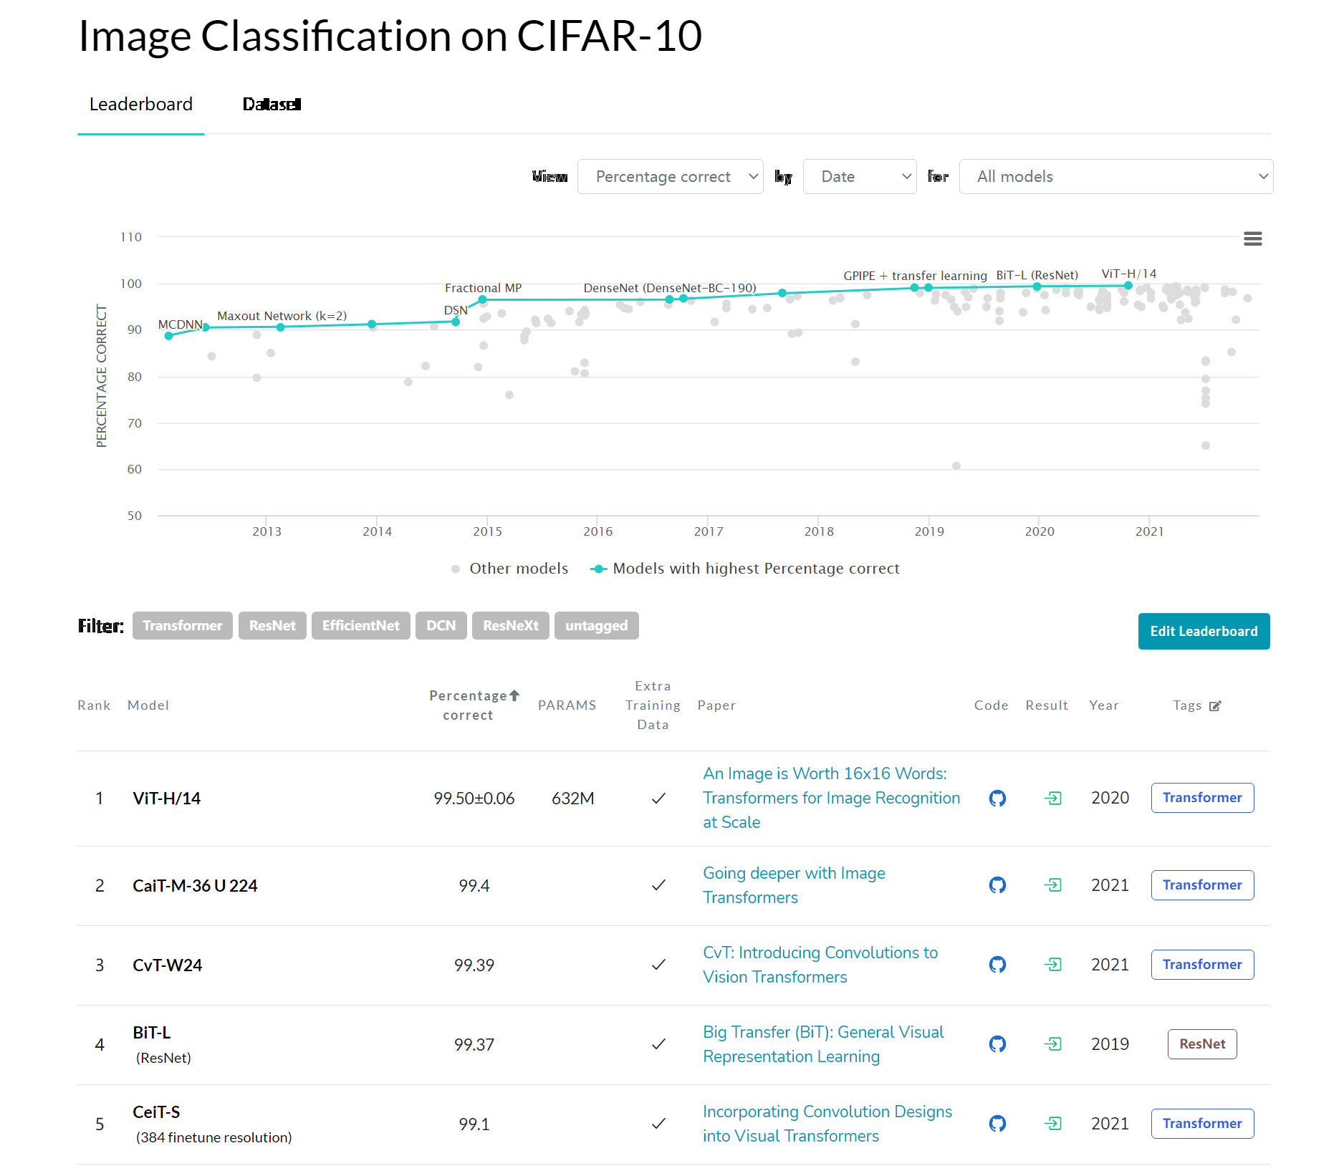
CIFAR-10 Benchmark (Image Classification) | Papers With Code

Slide 6
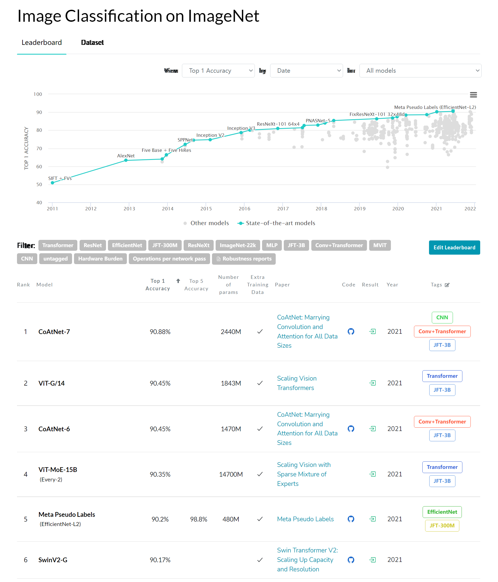
ImageNet Benchmark (Image Classification) | Papers With Code

Slide 8

COCO test-dev Benchmark (Object Detection) | Papers With Code
ViT is sweeping through all CV tasks
Most Top state-of-the-art CV methods are based on ViT or its variants

Slide 9
Goals&Structures

Slide 10
Our original goal: follow the original Transformer (Vaswani et al., 2017) as closely as possible.
Benefits: NLP Transformer architectures can be used almost out of the box
How to build our inputs?
Each pixel?
The whole image?

Slide 11
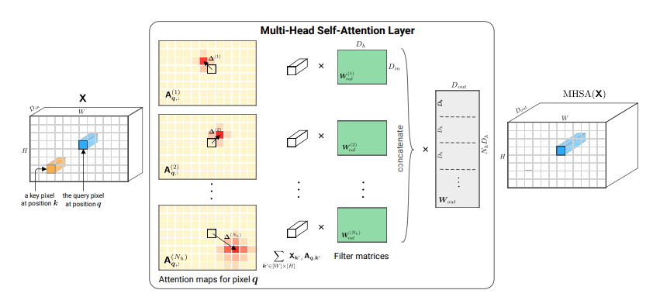
Some related work methods are:
patches of size 2×2
from the input image and applies full self-attention on top
[1911.03584] On the Relationship between Self-Attention and Convolutional Layers (arxiv.org)

Slide 12
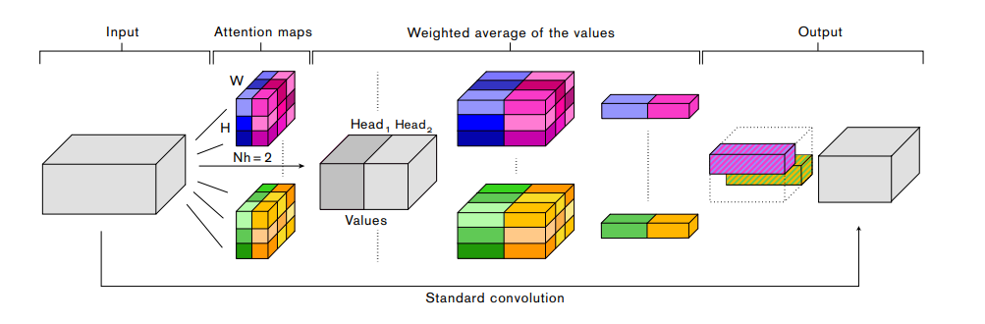
Some related work methods are:
patches of size 2×2
from the input image and applies full self-attention on top
combining CNNs with self-attention
Attention Augmented Convolutional Networks (thecvf.com)

Slide 13
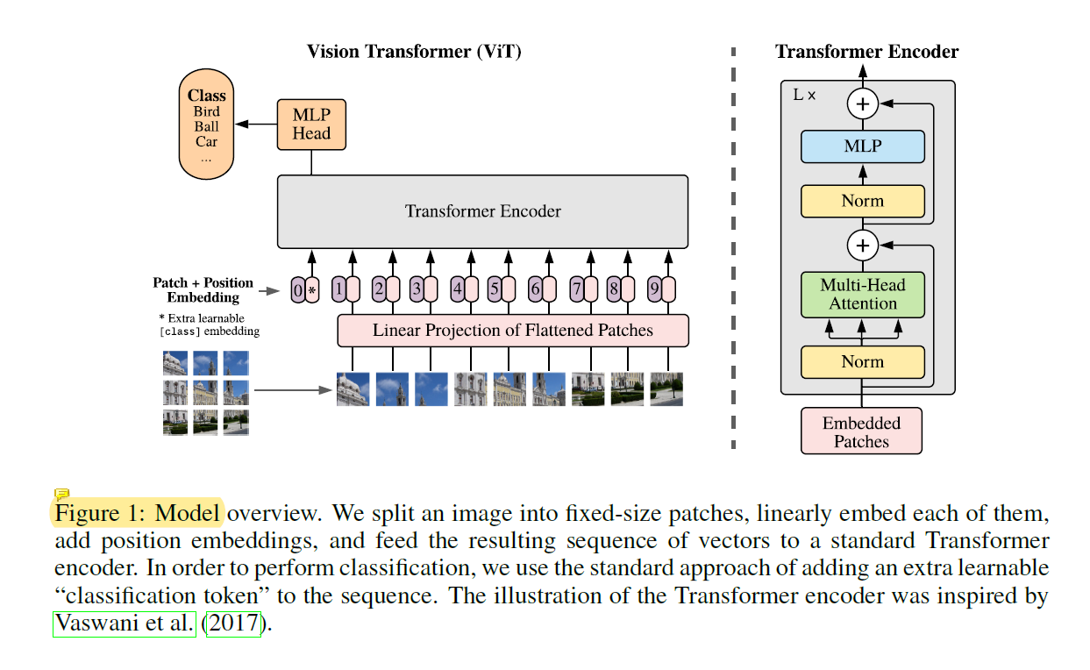
Workflows
split into patches
linearly embedding
add position embeddings
an extra learnable
“classification token”(cls)
Classification implemented on cls’s corresponding output

Slide 14
Why cls?
Why position embeddings, and how?
Notes:
Cls的可以收集所有token的信息，可以作为分类的标准；如果用现有的token的话就显得不公平；
在CNN：二维相邻结构、平移等变性、局部性
在Tran：只有MLP是局部而且平移等边的，但是self-attention是全局的
后面会看到不同的位置编码的效果
In CNNs, locality, two-dimensional neighborhood structure, and translation equivariance are baked into each layer throughout the whole model. In ViT, only MLP layers are local and transla-tionally equivariant, while the self-attention layers are global.

Slide 15
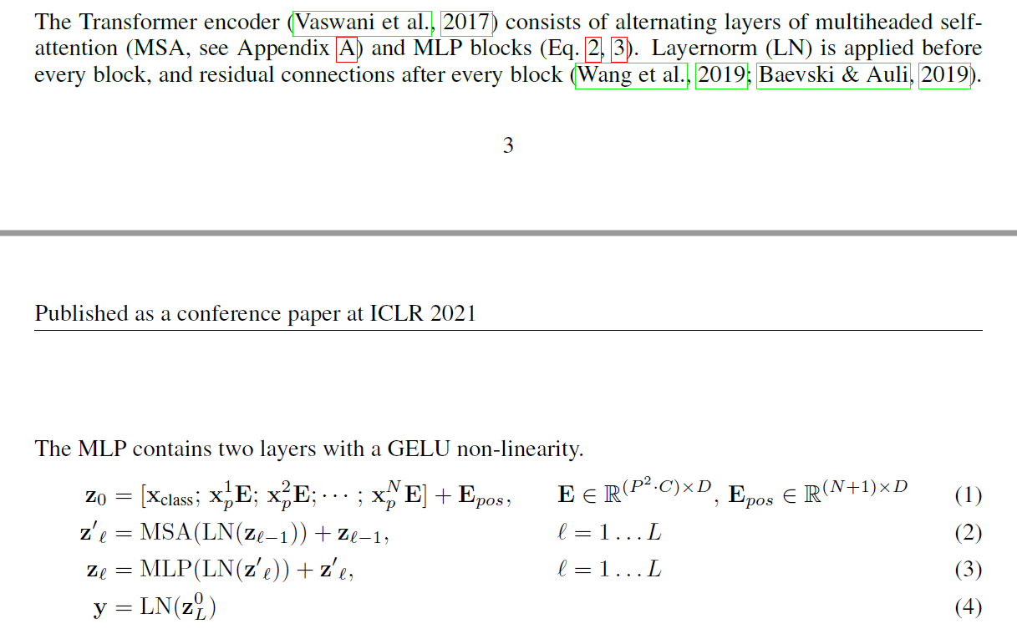

Slide 16
Results

Slide 17
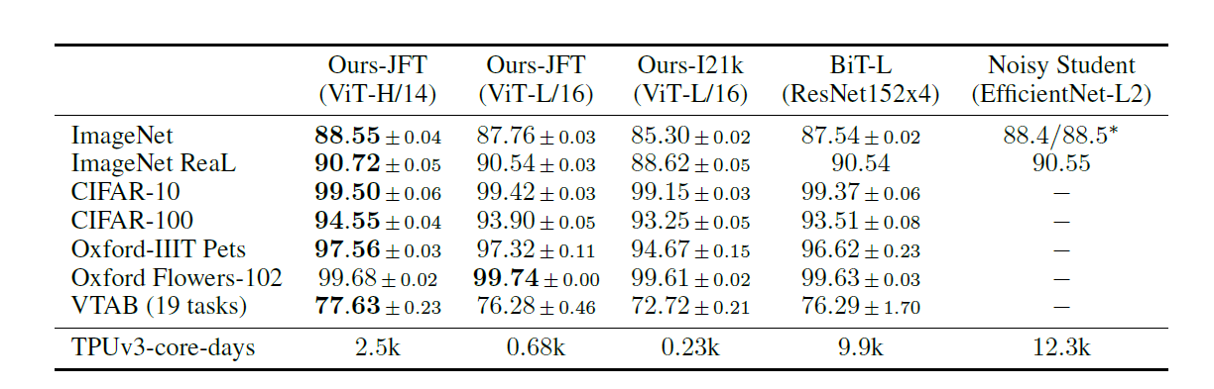
Comparison with state of the art on popular image classification benchmarks.
Higher accuracy(better)
Much less computational resources(cheaper)

Slide 18
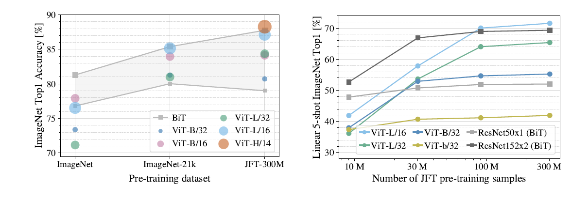
Take home message for you:
Vit perform worse than BiT ResNets when pre-trained on small datasets
but shine when pre-trained on larger datasets
A guideline for model-selection for your task
Notes:
为什么小的不行？

Slide 19
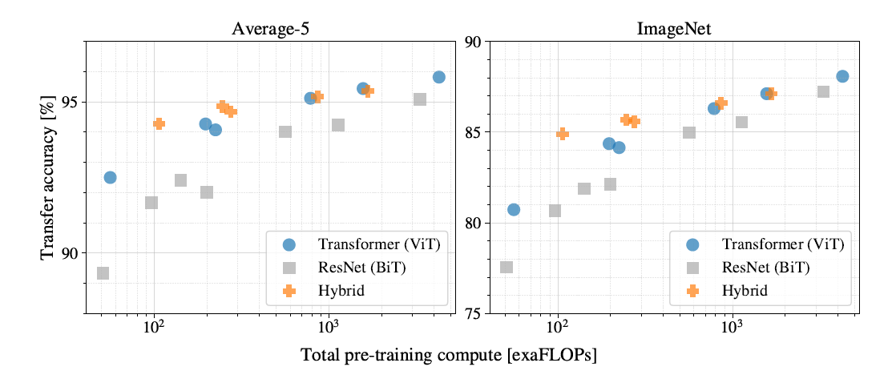
ViT generally outperform ResNets with the same computational budget
Hybrids improve upon pure Transformers, BUT just for smaller model sizes

Slide 20
Inspecting ViT

Slide 21
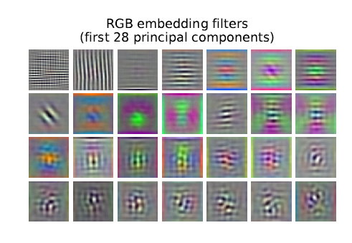
Filters of the initial linear embedding of RGB values of ViT-L/32
Looks similar to gabor filters/filters in CNNs
Notes:
做MLP的大E矩阵作为filter提取出来的特征和CNN其实很相像，能够提取出一些图像的颜色和纹理等信息，所以这些成分是可以作为图像块的底层的结构的

Slide 22
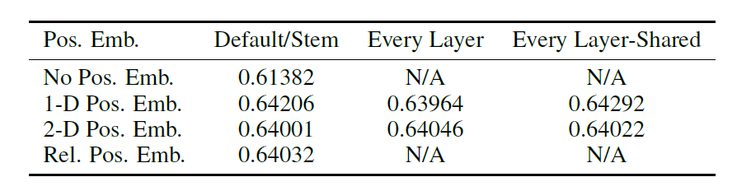
Position embedding comparison and visualization
Notes:
一定要加position信息
同行同列的相似性很高，所以是可以学习到位置信息的，而且不用2D，只需要1D就够用了

Slide 23
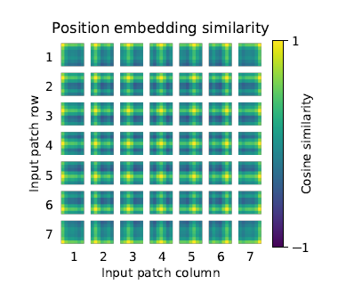
Position embedding comparison and visualization

Slide 24
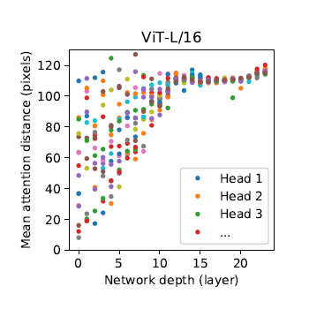
Heads are able to gather information form long distance, even at the foreside of the network
Attention distance keeps high and concentrative as depth goes
Notes:
最后一幅图表示了ViT可以注意到距离很远的信息，一开始就存在某些头可以注意到很远的信息，随着层数的增加可以看到学习到的距离还是保持很高而且分布越来越集中，这说明已经可以学习到带有语义信息的概念而不是临近像素点。

Slide 25
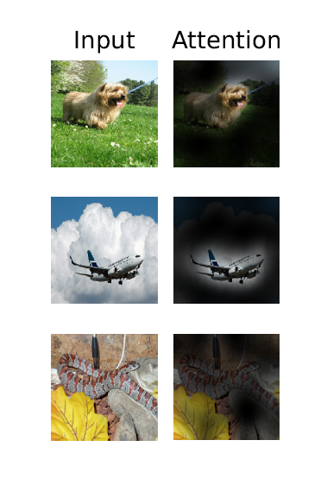
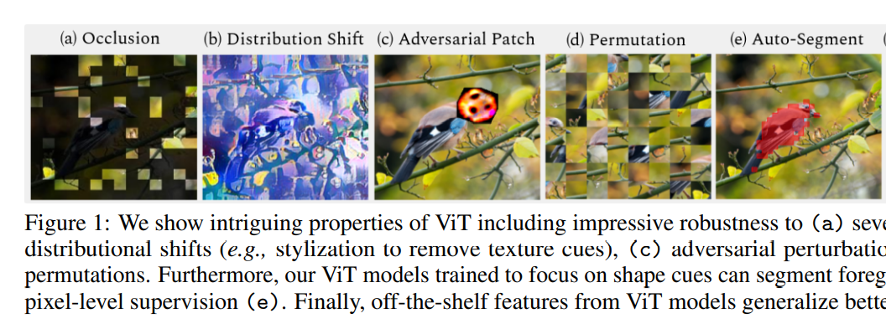
[2105.10497] Intriguing Properties of Vision Transformers (arxiv.org)
Notes:
验证网络真的学到了这些概念，这说明网络已经可以关注到和图像分类有关的区域

Slide 26
Conclusion:
Better &cheaper model on large-scale dataset
Broke down the barriers of NLP and CV, even more
Leading a new revolution in CV and AI

